Slide 1
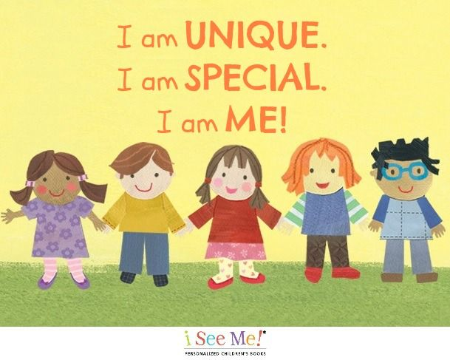
Mathematics
Subitising within 3
Focus on counting skills
Focus on composition of 3 and 4
Subitise objects and sounds
Use the language of comparison: more than and fewer than
Match, Sort & Compare
Match objects
Match pictures and objects
Identify a set
Sort objects to a type
Explore sorting techniques
Create sorting rules
Compare amounts
Talk about measure and patterns•
Compare size
Compare mass
Compare capacity
Explore simple patterns
Copy and continue simple patterns
Create simple patterns
Bluebell Class Autumn Term 1 Learning Journey
Understanding the World (UW):
Who am I?
Past and Present
Talk about members of their immediate family and community. Name and describe people who are familiar to them. Comment on images of familiar situations in the past. Compare and contrast characters from stories, including figures from the past.
People, Culture and Communities
Recognise that people have different beliefs and celebrate special times in different ways. Identify different groups that they belong to.
The Natural World
What body parts can I name?
What can I see/ hear/touch/ smell/ taste/see?
What do our bodies need to stay healthy?
Know there are 4 seasons and what they are called, know the weather changes in each of the seasons and how this affects what we wear. Observe change in the natural world – leaves,
Marvellous Me!
School Value: Compassion
Expressive Art and Design (EAD)
Observational drawing - Self portraits
Christmas cards
Colour mixing - Kandinsky
Clay - hedgehog
Design and make a hedgehog home
Using different media to create feelings drawing
Superhero me
Flange join
Role play – Home
Music: Charanga: Me!
Understand pulse and tempo whilst learning nursery rhymes.
Religious Education
(UW: People, Culture and Communities)
Who Are We?
Similarities and differences between ourselves and families.
What makes me special?
Who and what supports and guides me?
What makes us joyful, peaceful, wonder, reflect, happy and sad?
My family: Who is important to me? Who helps me?
Bible stories include: The Boy in the Temple, The parable of the lost coin, Jonah the Groaner, In the Beginning
Personal, Social and Emotional development
Class and school routines, learning code and expectations.
Building relationships with peers and adults.
Jigsaw: Being Me In My World
Physical Development
Mark making, cutting with scissors. Letter formation for our name, patterns for letter formation.
Knowing how to move in different spaces.
Communication and Language/Literacy
Key Texts:
‘The Everywhere Bear’ by Julia Donaldson
‘Supertato’ by Sue Hendra
‘A Little Bit Brave’ by Nicola Kinnear
Retelling known stories and making changes to create new versions. Rhyming and rhythmic activities. Maintaining concentration for short periods. Following simple one and 2 step instructions.
Blend CVC words for reading. Write left to write and top to bottom. With adult support, separate words with spaces, using a finger or space guide. ‘Hold’ and write a simple word or phrase which has been orally composed as a group/class eg. a big cat, the mad pig, Form these letters mostly correctly s a t p i n m d g o c k ck e u r h b f ff l ll ss. Transcribe CVC words or phrases as part of phonics lessons.
Phonics:
Phase 1 - Sounds around us, oral blending
Phase 2 - phonemes (sounds): s a t p i n m d g o c k ck e u r h b f ff l ll ss
Phase 2 common exception words (CEWs) - the, to, into, no, I, go
Key vocabulary
Please, thank you, sorry, help, family, mum/mummy, dad/daddy, brother, sister, auntie, uncle, grandma, grandad, friend, same, different, older, younger, favourite, like, dislike, adopted.
Suggestions for Home Learning
Support your child’s reading journey with regular practice of phoneme flashcards. Click here to support your own knowledge of the correct pronunciation of each phoneme.
When they are ready, hear your child read their decodable reading book 5 times a week, and log this in their reading record.
Keep practicing putting on their own jumper/cardigan, coat and fastening it.
Play matching and sorting games.
Talk about people in your family, both those who live with you as well as wider family.

