Slide 1
St Mary’s CE Primary School
A breach year for Reception for academic year 2017/2018

Slide 2
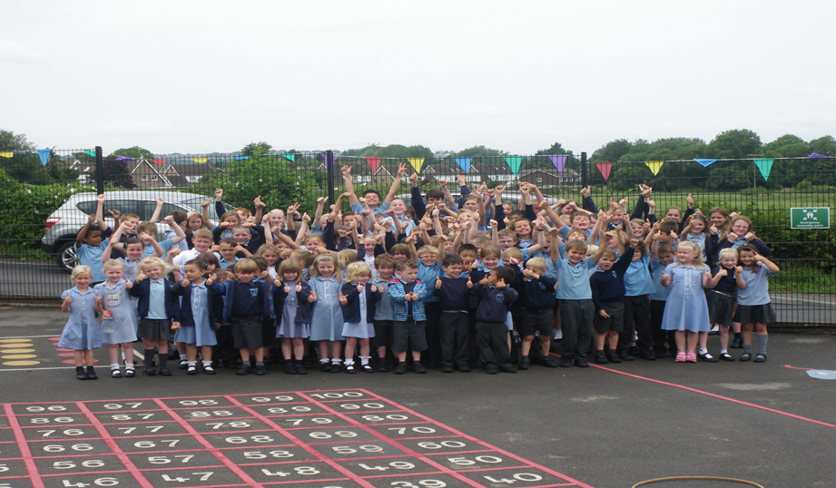
St Mary’s CE Primary School
“A Caring, Christian Community, Committed to Achievement”

Slide 3
A Breach year
St Mary’s usually admits up to 15 children per class each September but this coming year the governors will extend that number to a maximum of 30 pupils for the Reception Class 2017.
This is called a Breach year. It is a decision for this September only, to accept an additional 15 pupils.

Slide 4
How the decision was made.
19 families wanted St Mary’s as their first choice
11 families in Portishead needed a school place
All primary schools in Portishead have taken breach years and the number of children needing a place didn’t constitute a whole class.

Slide 5
Why St Mary’s
We have the classroom space – the classroom is built to accommodate 30 children
We have the teaching capacity
We need to ensure our long term sustainability, in terms of pupil numbers and in turn financially, this is a positive step forward
St Mary’s is a school well on the way to “Outstanding” and has the capacity to cope with change

Slide 6
How will the class move through the school?
We can assume that 15 children will join us in Reception in September 2018. if that is the case the breach Class will need to be organised into 2 groups of 15 children every other year. This will be done by date of birth unless there is another reason for instance a children with a specific learning need.
The following grids show how the class will move through the school.
The blue shading indicates this class as it moves through the school.

Slide 7
Class Organisation 2017/18 assuming a breach in YR to 30 pupils in 2017/18
 | Bluebell Class | Windmill Class | Conygar Class | Priory Class | Total in Yr Group | Admission Level
REC | 30 |  |  |  | 30 | 30
Y1 |  | 12 |  |  | 12 | 15
Y2 |  | 15 |  |  | 15 | 15
Y3 |  |  | 15 |  | 15 | 15
Y4 |  |  | 14 |  | 14 | 15
Y5 |  |  |  | 14 | 14 | 15
Y6 |  |  |  | 16 | 16 | 15
Total in Class | 30 | 27 | 29 | 29 | 116 | 120

Slide 8
Class Organisation 2018/19 assuming a breach in YR to 30 pupils in 2017/18
 | Bluebell Class | Windmill Class | Conygar Class | Priory Class | Total in Yr Group | Admission Level
REC | 15 |  |  |  | 15 | 15
Y1 | 15 | 15 |  |  | 30 | 30
Y2 |  | 12 |  |  | 12 | 15
Y3 |  |  | 15 |  | 15 | 15
Y4 |  |  | 15 |  | 15 | 15
Y5 |  |  |  | 14 | 14 | 15
Y6 |  |  |  | 14 | 14 | 15
Total in Class | 30 | 27 | 30 | 28 | 115 | 120

Slide 9
Class Organisation 2019/20 assuming a breach in YR to 30 pupils in 2017/18
 | Bluebell Class | Windmill Class | Conygar Class | Priory Class | Total in Yr Group | Admission Level
REC | 15 |  |  |  | 15 | 15
Y1 | 15 |  |  |  | 15 | 15
Y2 |  | 30 |  |  | 30 | 30
Y3 |  |  | 12 |  | 12 | 15
Y4 |  |  | 15 |  | 15 | 15
Y5 |  |  |  | 15 | 15 | 15
Y6 |  |  |  | 14 | 14 | 15
Total in Class | 30 | 30 | 27 | 29 | 116 | 120

Slide 10
Class Organisation 2020/21 assuming a breach in YR to 30 pupils in 2017/18
 | Bluebell Class | Windmill Class | Conygar Class | Priory Class | Total in Yr Group | Admission Level
REC | 15 |  |  |  | 15 | 15
Y1 | 15 |  |  |  | 15 | 15
Y2 |  | 15 |  |  | 15 | 15
Y3 |  | 15 | 15 |  | 30 | 30
Y4 |  |  | 12 |  | 12 | 15
Y5 |  |  |  | 15 | 15 | 15
Y6 |  |  |  | 15 | 15 | 15
Total in Class | 30 | 30 | 27 | 30 | 117 | 120

Slide 11
Class Organisation 2021/22 assuming a breach in YR to 30 pupils in 2017/18
 | Bluebell Class | Windmill Class | Conygar Class | Priory Class | Total in Yr Group | Admission Level
REC | 15 |  |  |  | 15 | 15
Y1 | 15 |  |  |  | 15 | 15
Y2 |  | 15 |  |  | 15 | 15
Y3 |  | 15 |  |  | 15 | 15
Y4 |  |  | 30 |  | 30 | 30
Y5 |  |  |  | 12 | 12 | 15
Y6 |  |  |  | 15 | 15 | 15
Total in Class | 30 | 30 | 30 | 27 | 117 | 120

Slide 12
Class Organisation 2022/23 assuming a breach in YR to 30 pupils in 2017/18
 | Bluebell Class | Windmill Class | Conygar Class | Priory Class | Total in Yr Group | Admission Level
REC | 15 |  |  |  | 15 | 15
Y1 | 15 |  |  |  | 15 | 15
Y2 |  | 15 |  |  | 15 | 15
Y3 |  | 15 |  |  | 15 | 15
Y4 |  |  | 15 |  | 15 | 15
Y5 |  |  | 15 | 15 | 30 | 30
Y6 |  |  |  | 12 | 12 | 15
Total in Class | 30 | 30 | 30 | 27 | 117 | 120

Slide 13
Class Organisation 2023/24 assuming a breach in YR to 30 pupils in 2017/18
 | Bluebell Class | Windmill Class | Conygar Class | Priory Class | Total in Yr Group | Admission Level
REC | 15 |  |  |  | 15 | 15
Y1 | 15 |  |  |  | 15 | 15
Y2 |  | 15 |  |  | 15 | 15
Y3 |  | 15 |  |  | 15 | 15
Y4 |  |  | 15 |  | 15 | 15
Y5 |  |  | 15 |  | 15 | 15
Y6 |  |  |  | 30 | 30 | 30
Total in Class | 30 | 30 | 30 | 30 | 120 | 120

